Slide 1
Motif Gallery
12 May 2026

Slide 2
Goals
Metric: a measure of conservation between two positions (e.g. information content and other derivatives)
Score: measure of continuous diagonal strength among 2+ consecutive positions
Tasks
Threshold more adaptively with distribution of metrics
Deal with poly-N hits, more readable output (map_back function)
Demonstrate examples of direct and reverse detection
More integrated BioMotif object handling

Slide 3
Thresholding
Before: fixed information content constant
Now: Percentile based on matrix of conservation metric

Slide 4
Poly-N / Mapping Back to Readable Output
Function def map_back
Input motif, array of candidates from score_diagonals
Use this to filter out poly-N patterns
coords | length | score | group1 | group2
[(16, 5), (17, 6), (18, 7), (19, 8)] | 4 | 6.81434819 | GTCA | GTCA
[(11, 10), (12, 11), (13, 12)] | 3 | 5.67136648 | AAA | AAA
[(9, 7), (10, 8)] | 2 | 3.5316342 | CA | CA
[(10, 1), (11, 2)] | 2 | 2.51581179 | AA | AA
[(11, 1), (12, 2)] | 2 | 2.48348188 | AA | AA
[(12, 10), (13, 11)] | 2 | 3.76452051 | AA | AA
[(18, 9), (19, 10)] | 2 | 3.5316342 | CA | CA
[(21, 10), (22, 11)] | 2 | 3.35063117 | AA | AA
[(21, 11), (22, 12)] | 2 | 3.32919146 | AA | AA
[(21, 12), (22, 13)] | 2 | 3.2029027 | AA | AA

Slide 5
Bootstrapping Scores
Concept – is our set of diagonal candidates nonrandom, conditional on the observed score distribution?
Same shuffle applied to rows and columns – do not shuffle both axes independently, as the goal is to break the position-wise relationship
Initial missteps
Thresholding with IC-JSD – want a more objective threshold, go for information only
Some iterations might have no output if threshold isn’t met – fix with default zero

Slide 6
Function Library Directory
make_ppm - compute BP proportions in aligned sequences
complement_ppm – simply rearrange bases ATCG → GCTA
compute_metrics – PIC-JSD, PIC, JSD, Pearson
positional_information_content
jensen_shannon
pearson
score_diagonals
shuffle_metrics
scoring_bootstrap
visualize_matrix
histogram_scores
map_back

Slide 7
Ex1 Mo1 80pct threshold

Slide 8
Ex1 Mo1 Output
coords | length | score | group1 | group2
[(16, 5), (17, 6), (18, 7), (19, 8)] | 4 | 6.814348186 | GTCA | GTCA
[(11, 10), (12, 11), (13, 12)] | 3 | 5.671366478 | AAA | AAA
[(9, 7), (10, 8)] | 2 | 3.531634204 | CA | CA
[(10, 1), (11, 2)] | 2 | 2.515811795 | AA | AA
[(11, 1), (12, 2)] | 2 | 2.483481881 | AA | AA
[(12, 10), (13, 11)] | 2 | 3.764520512 | AA | AA
[(18, 9), (19, 10)] | 2 | 3.531634204 | CA | CA
[(21, 10), (22, 11)] | 2 | 3.350631165 | AA | AA
[(21, 11), (22, 12)] | 2 | 3.329191463 | AA | AA
[(21, 12), (22, 13)] | 2 | 3.202902699 | AA | AA

Slide 9
Ex1 Mo1 80pct Reverse
Notes:
17,8 -- 16, 9 – 15, 10

Slide 10
Ex1 Mo1 Output – Try Reverse
coords | length | score | group1 | group2
[(14, 9), (15, 8), (16, 7)] | 3 | 4.206712 | GTG | CAC
[(15, 10), (16, 9), (17, 8)] | 3 | 4.993712 | TGT | ACA
[(8, 6), (9, 5)] | 2 | 2.783439 | AC | TG
[(18, 16), (19, 15)] | 2 | 3.340354 | CA | GT
[(22, 20), (23, 19)] | 2 | 2.154894 | AT | TA
[(23, 11), (24, 10)] | 2 | 2.186579 | TT | AA
[(23, 12), (24, 11)] | 2 | 2.196703 | TT | AA
[(23, 13), (24, 12)] | 2 | 2.10655 | TT | AA
[(23, 22), (24, 21)] | 2 | 1.991468 | TT | AA

Slide 11
Ex1 Mo2 80pct threshold

Slide 12
Ex1 Mo2 Output
coords | length | score | group1 | group2
[(21, 0), (22, 1), (23, 2), (24, 3), (25, 4)] | 5 | 9.649394 | GTAAA | GTAAA
[(3, 2), (4, 3)] | 2 | 3.649394 | AA | AA
[(10, 0), (11, 1)] | 2 | 3.896872 | GT | GT
[(13, 1), (14, 2)] | 2 | 2.17438 | TA | TA
[(14, 4), (15, 5)] | 2 | 1.86434 | AG | AG
[(21, 10), (22, 11)] | 2 | 3.896872 | GT | GT
[(22, 13), (23, 14)] | 2 | 2.365965 | TA | TA
[(23, 3), (24, 4)] | 2 | 4 | AA | AA
[(24, 2), (25, 3)] | 2 | 3.649394 | AA | AA
[(24, 23), (25, 24)] | 2 | 4 | AA | AA

Slide 13
Ex1 Mo2 80pct Try Reverse

Slide 14
Ex1 Mo2 Output
coords | length | score | group1 | group2
[(20, 10), (21, 9), (22, 8)] | 3 | 3.33551 | CGT | GCA
[(8, 1), (9, 0)] | 2 | 1.860874 | AC | TG
[(9, 7), (10, 6)] | 2 | 1.479916 | CG | GC
[(10, 9), (11, 8)] | 2 | 1.881161 | GT | CA
[(11, 2), (12, 1)] | 2 | 2.108458 | TA | AT
[(13, 2), (14, 1)] | 2 | 2.227702 | TA | AT
[(13, 12), (14, 11)] | 2 | 1.545232 | TA | AT
[(20, 7), (21, 6)] | 2 | 1.204598 | CG | GC
[(22, 2), (23, 1)] | 2 | 3.649394 | TA | AT
[(22, 12), (23, 11)] | 2 | 2.457249 | TA | AT
[(22, 14), (23, 13)] | 2 | 2.365965 | TA | AT

Slide 15
CollecTF - Experimental test cases
These all bind as dimers – expect inverted repeats:
LexA – When damage is detected, LexA is destroyed, turning the repair genes "on".
FNR – Senses oxygen. Helps switch between breathing aerobic and anaerobic
CRP – activates >100 genes in energy metabolism. If a bacterium runs out of glucose, CRP turns on genes to digest other secondary sugars (like lactose)
A stranger case: Fur
Ferric Uptake Regulator -- controls how bacteria handle iron
If a cell absorbs too much iron, Fur binds to DNA to shut down iron-absorbing genes
For decades, scientists argued about what the Fur motif looked like
19-bp palindrome model with one dimer → subset heptamer inverted repeats (7-1-7)² overlapping internal structure with 21-bp sequence
Basically, Fur’s binding site isn’t just a fixed concrete set – need to check for internal subset symmetry too → captures real biological chaos from multiple dimers
Notes:
https://www.researchgate.net/figure/LexA-repressor-dimer-bound-to-its-cognate-SOS-boxes-PDB-code-3JSO-a-Schematic_fig11_263936900

Slide 16
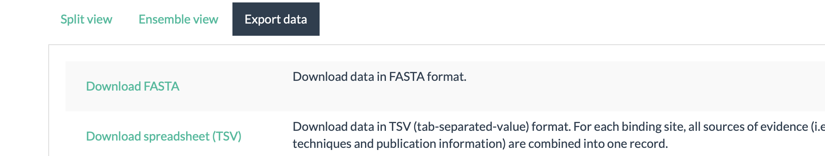
File I/O to process bulk .fas files
General structure from CollecTF >TF_{protein}_{UniProt_ID}|genome_{accession} {organism}|start={n}|end={n}|strand={direction}
E.g.
>TF_Fur_P0C6C8|genome_NC_002505.1 Vibrio cholerae O1 biovar El Tor str. N16961|start=...|end=...|strand=...
3 keys:
P0C6C8 — UniProt ID (unique protein)
NC_002505.1 — genome accession (unique assembly)
Vibrio cholerae O1 biovar El Tor str. N16961 — organism name (human-readable)
Settled file structure:
CollectTF_FASTA / Fur / Vibrio_cholerae_O1_biovar… / TF_Fur_P0C6C8.fas

Slide 17
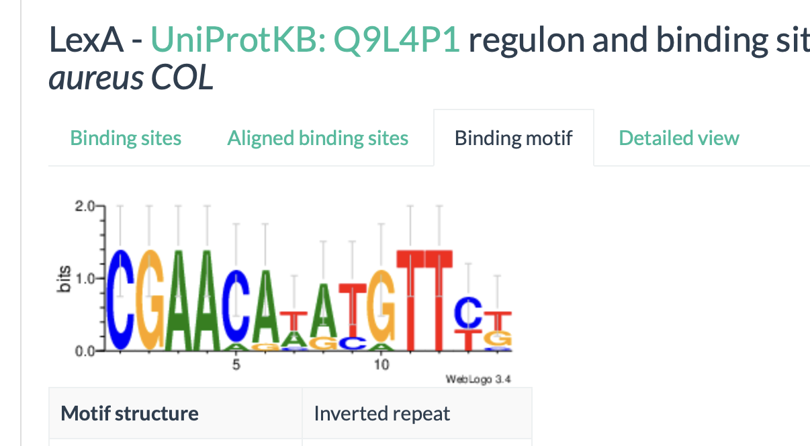
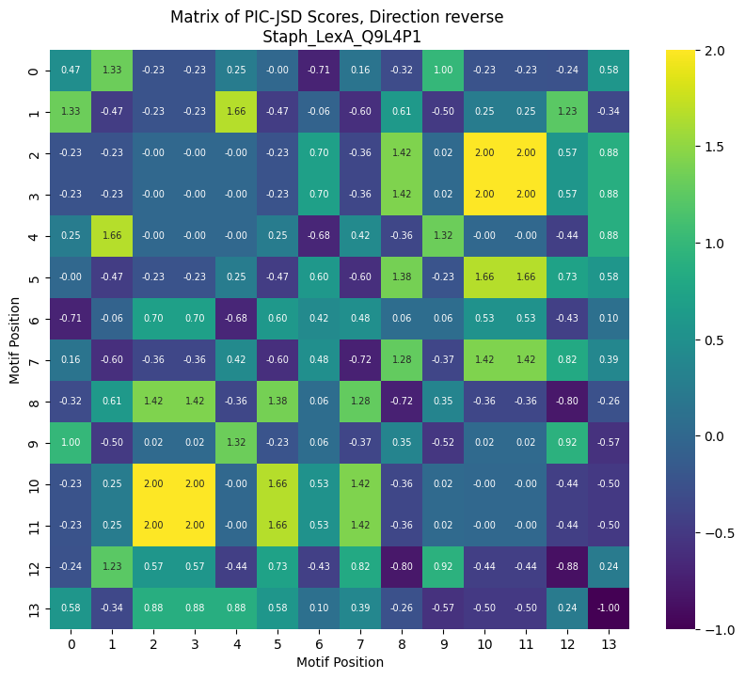
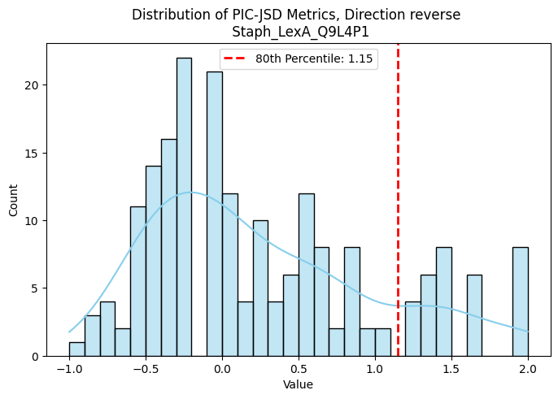
Initial test case – Staph Q9L4P1
coords | length | score | group1 | group2 | p_value
[(8, 5), (9, 4), (10, 3), (11, 2), (12, 1)] | 5 | 7.930041 | TGTTC | ACAAG | 0

Slide 18
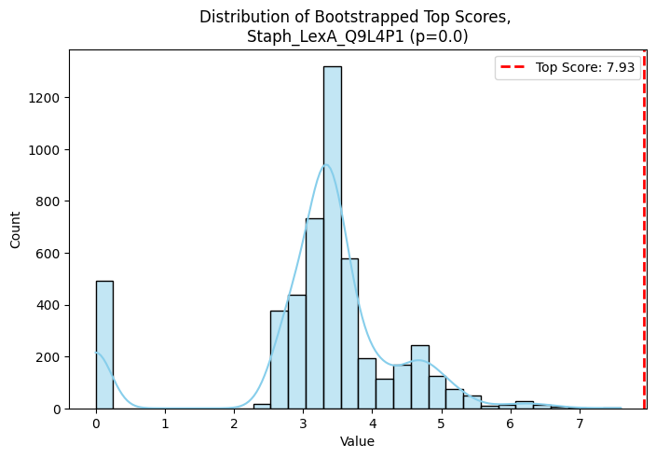

Slide 19
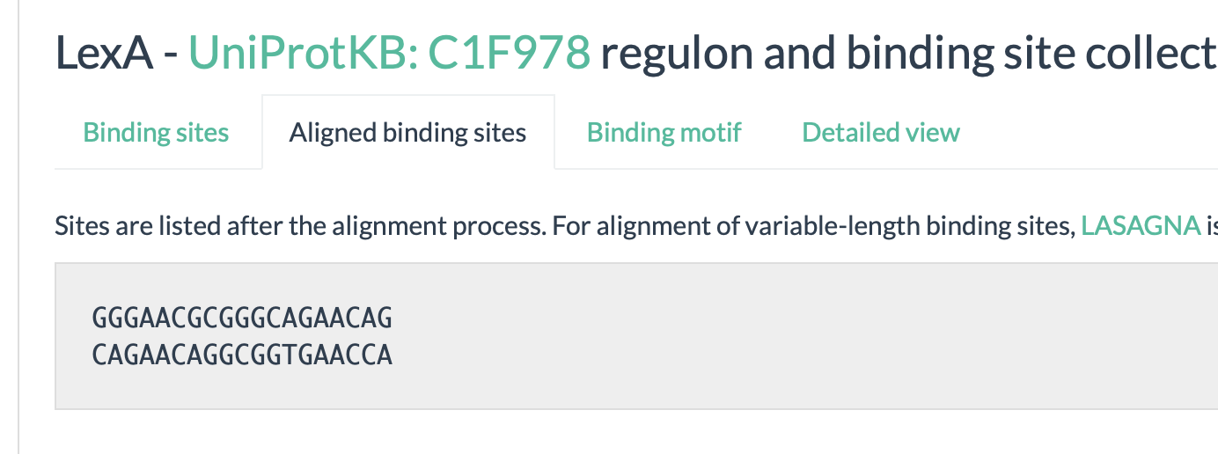
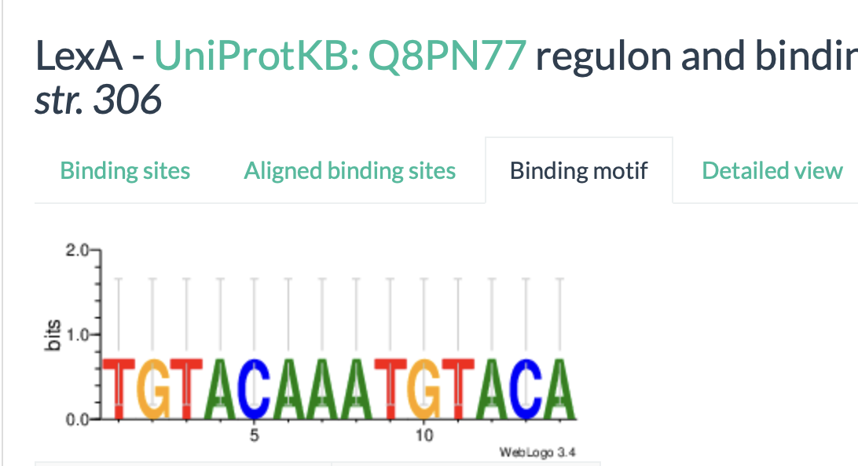
Next steps
Test more real cases
Behavior in one or low-sample cases
Null cases (truly no signal)
Mapping back to consensus sequence – check robustly to ambiguity
IR map back for better readability

Slide 20
Null case generator
Generate random sequences of length N
Create a motif and compute the IC
Select one random position from one of the sequences, and change the base pair
Compute IC. If the IC is lower then discard the change, if not, discard the change
Goal is to construct high-IC situation
Loop

Slide 21
CollecTF Gallery
26 May 2026

Slide 22
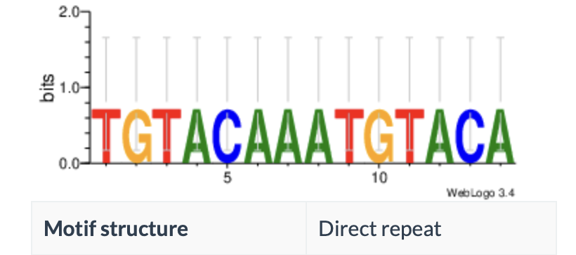
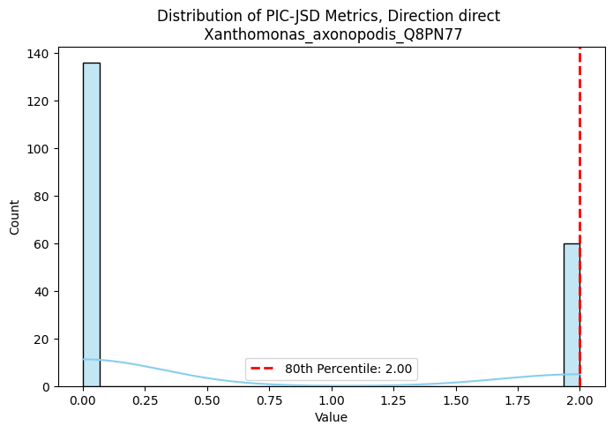
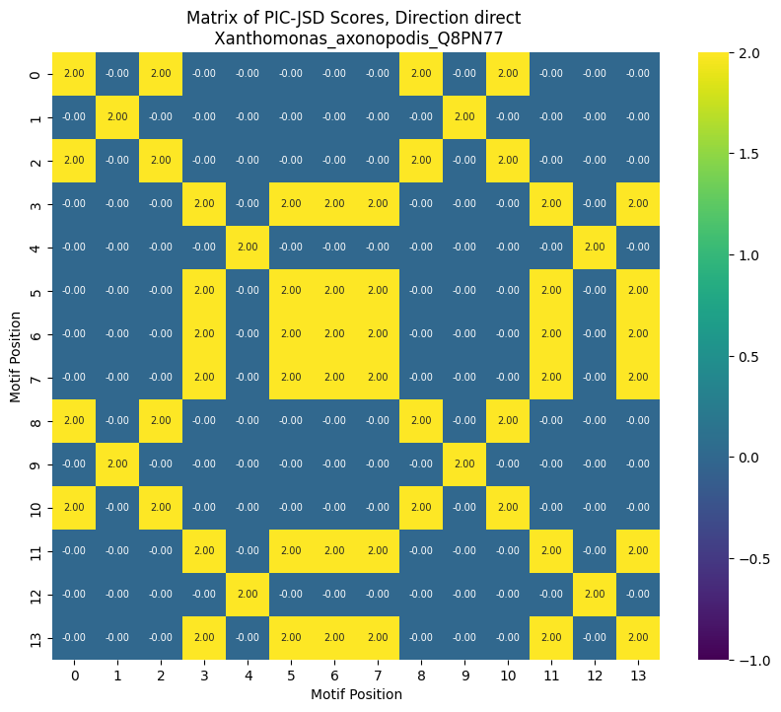
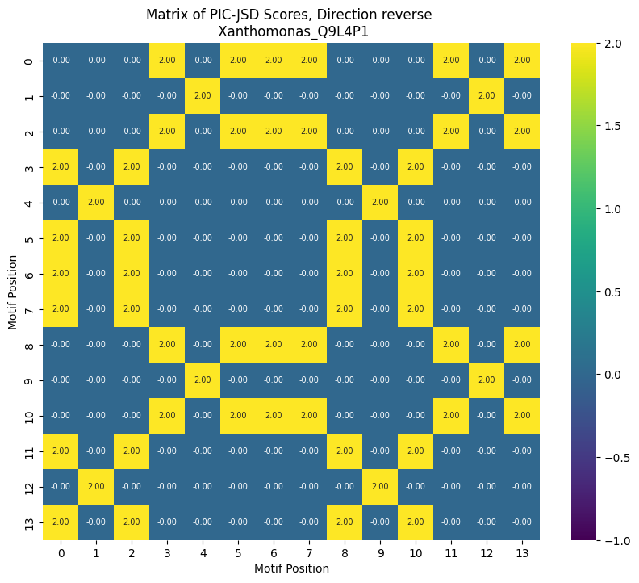
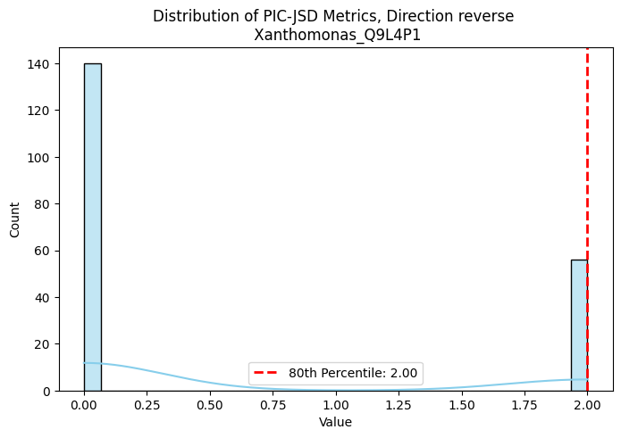
One-sample case
LexA - UniProtKB: Q8PN77
Both a reverse and direct

Slide 23
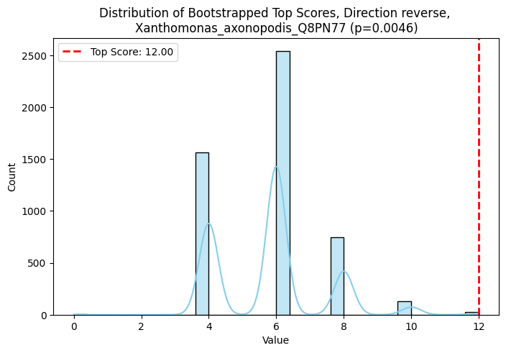
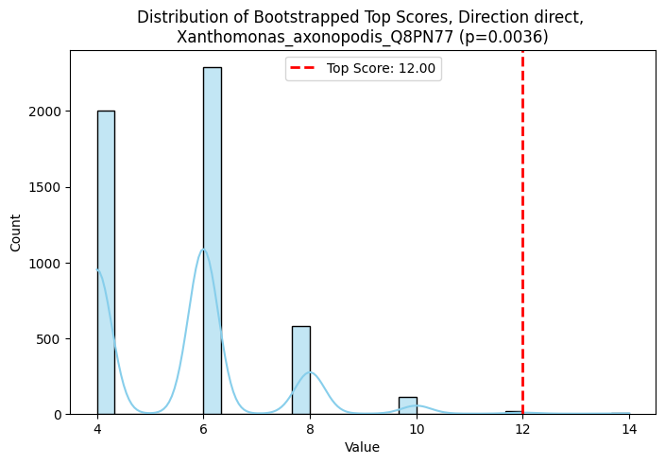
One-sample case – analysis (bidirectional)
coords | length | score | group1 | group2 | p_value
[(8, 5), (9, 4), (10, 3), (11, 2), (12, 1), (13, 0)] | 6 | 12 | TGTACA | ACATGT | 0.0046
[(3, 2), (4, 1), (5, 0)] | 3 | 6 | ACA | TGT | 0.6868
[(11, 10), (12, 9), (13, 8)] | 3 | 6 | ACA | TGT | 0.6868
coords | length | score | group1 | group2 | p_value
[(8, 0), (9, 1), (10, 2), (11, 3), (12, 4), (13, 5)] | 6 | 12 | TGTACA | TGTACA | 0.0036
[(6, 5), (7, 6)] | 2 | 4 | AA | AA | 1

